Slide 1

Milestone 2: Feature Engineering, Baseline Model & Interpretability
Albina Cako and Joshua Dalphy

Slide 2
Methodology
BOW Count
BOW TF-IDF
Cleaned Data
Transform Data
Feature Extraction
Models
BOBG Count
Evaluation
BOBG TF-IDF

Slide 3
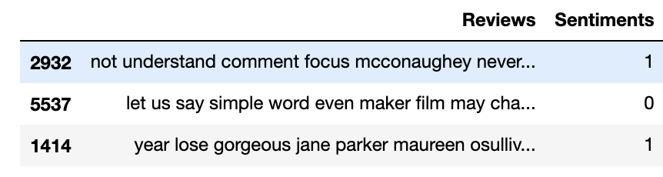
Data Transformation
Changed sentiment labels:
Positive sentiments = 1
Negative sentiments = 0
Separated Sentiment & Reviews from dataframe
Split data into train and test sets (70/30)
https://medium.com/@datamonsters/sentiment-analysis-tools-overview-part-1-positive-and-negative-words-databases-ae35431a470c

Slide 4
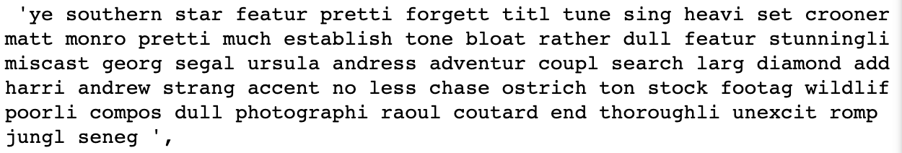
Data Transformation
The movie reviews were stemmed
Digits (0-9) were removed as well
https://medium.com/@datamonsters/sentiment-analysis-tools-overview-part-1-positive-and-negative-words-databases-ae35431a470c

Slide 5
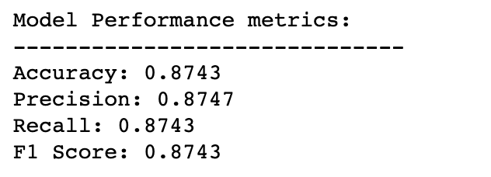
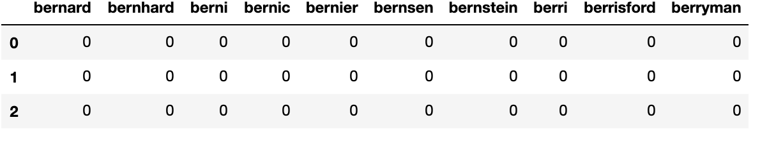
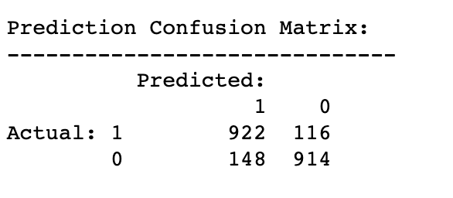
Feature Extraction & Baseline Modelling 1) Bag of Words - Count
Performed BOW on training/testing sets
Created 24959 features
Logistic Regression Performance

Slide 6
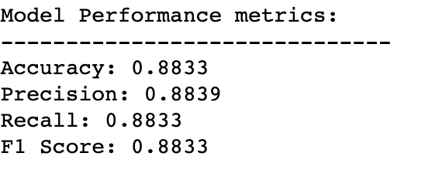
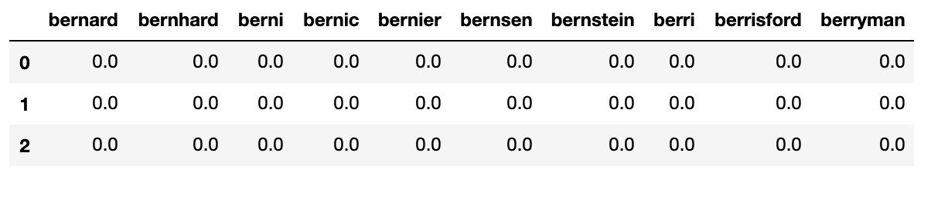
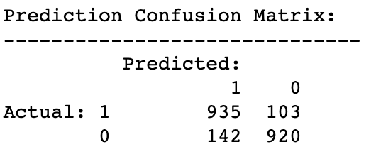
Feature Extraction & Baseline Modelling 2) Bag of Words – TF-IDF
Performed TF-IDF on BOW 24959 features
Logistic Regression Performance

Slide 7
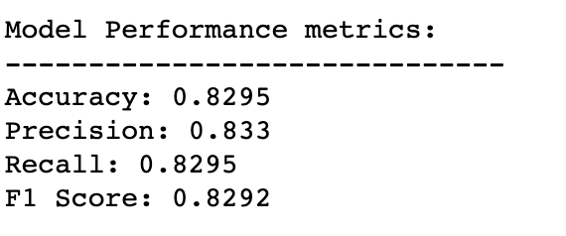
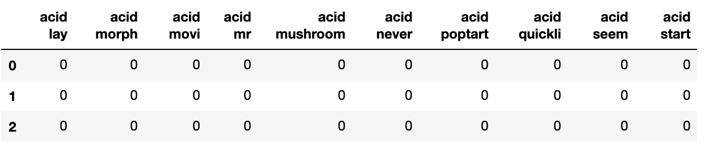
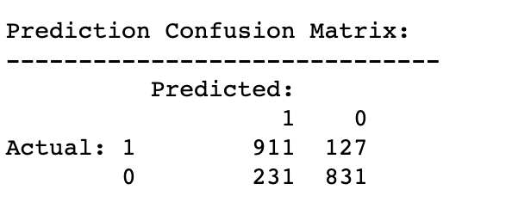
Feature Extraction & Baseline Modelling 3) Bag of Bi-Grams - Count
Logistic Regression Performance
Performed BOBG on training/testing sets
Created 385 586 features

Slide 8
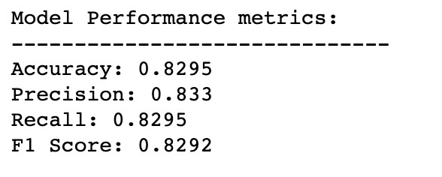
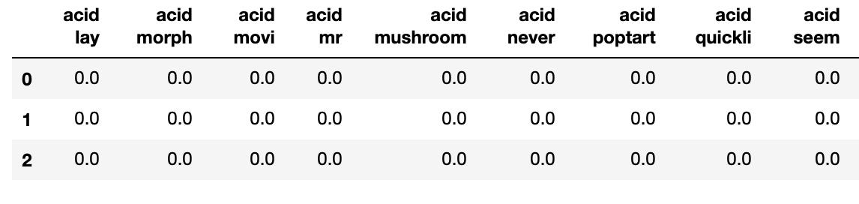
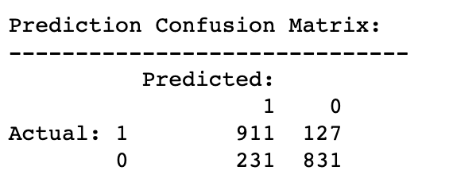
Feature Extraction & Baseline Modelling 4) Bag of Bi-Grams – TF-IDF
Logistic Regression Performance
Performed TF-IDF on BOBG 385 586 features

Slide 9
Model Interpretation 1) Bag of Words - Count vs. TF-IDF
Summary of Results:
Extraction | Accuracy | False Positives | False Negatives
Count | 0.8743 | 148 | 116
TF-IDF | 0.8833 | 142 | 103
Model produced using TF-IDF had better accuracy (approx. 1%)
The TF-IDF model has a lower false positive and false negative rate then the count method.
Both models have higher false positive rates than false negative rates.
Runtime Performance:
Count: 851 ms
TF-IDF: 293 ms
The TF-IDF trained model outperformed the count model

Slide 10
Model Interpretation 1) Bag of Bi-Grams Count vs. TF-IDF
Summary of Results:
Extraction | Accuracy | False Positives | False Negatives
Count | 0.8295 | 231 | 127
TF-IDF | 0.8295 | 231 | 127
The results were the same for both the count and TF-IDF models.
Applying TF-IDF did not make a difference in terms of accuracy or false negatives/positives
Runtime Performance:
Count: 3.08 s
TF-IDF: 2.61 s
Given that both models yielded same statistical results, based on runtime the TF-IDF trained model outperformed the count model

Slide 11
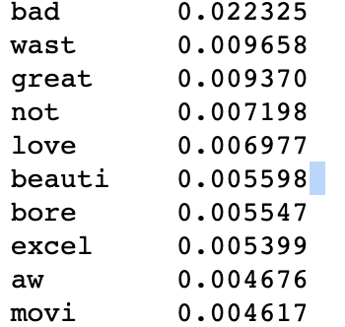
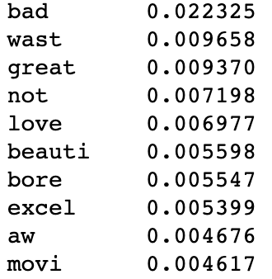
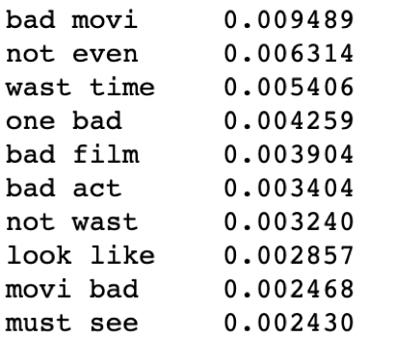
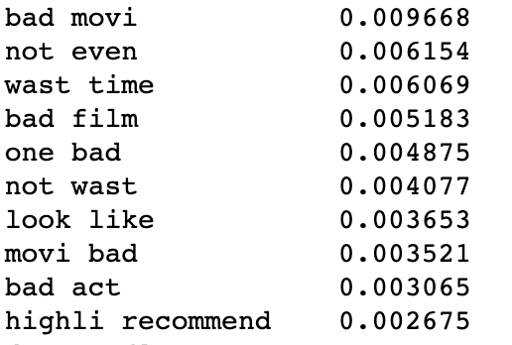
Feature Importance Using Random Forest
Bag of Words
Count TF-IDF
Bag of Bi-Grams
Count TF-IDF

Slide 12
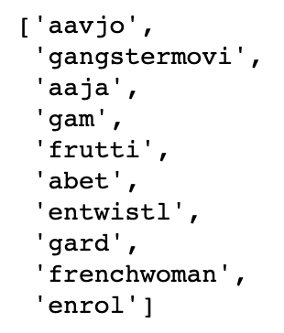
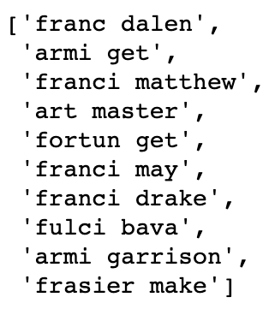
Feature Importance Using Random Forest
Bag of Words - Count
Number of unimportant features:
12955 of total 24959
Bag of Bi-Grams – TF-IDF
Number of unimportant features:
300998 of total 385586

Slide 13
Conclusions & Future Work
Conclusions:
4 models were produced using BOW (Count and TF-IDF) and BOBG (Count and TF-IDF) for feature extraction.
Logistic regression was chosen for baseline modelling.
Model performance was evaluated based on accuracy and runtime.
Random forest was used assess feature importance.
The best performing model was using the features extracted through Bag of Words - TF-IDF.
Future Work:
Hyperparameter tuning on the baseline model obtained using BOW TF-IDF.
Model evaluation and comparison.

